Slide 1








Pathotyping and Antimicrobial Susceptibility Profiling of Escherichia coli Isolated from Informal Water Sources in Kibera Informal Settlements.
Teresia Nyaga^{1,2}, Edinah Song’oro³, Elizabeth Matey⁴, Jenifer Njuhigu², Peter Nthiga⁵, Susan Githii^{1,2}
¹National Public Health Laboratories (KNPHI)
²⁵National Public Health Institute
³ Department of Medical Microbiology, COHES, JKUAT
⁴ Kenya Medical Research Institute
⁵ University of the Free State - Next Generation Sequencing Unit
One Health approach and climate-sensitive health threats.
Kenya Health Security Convention | 8th May 2026 | Mombasa - Kenya

Slide 2
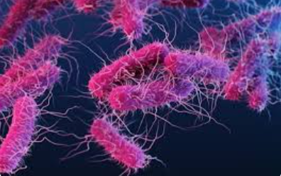
Background
E. coli is priority pathogens for AMR surveillance and fecal contamination indicator in WHO.
It causes 250 million infections and 65,000 deaths annually in Sub-Saharan Africa
Infections are spread through contaminated water, food, or fecal-oral routes.
Globally, about 2 billion people consume water contaminated with fecal matter, including over 50% of the population in sub-Saharan Africa and more than half of the population in Kenya.

Slide 3
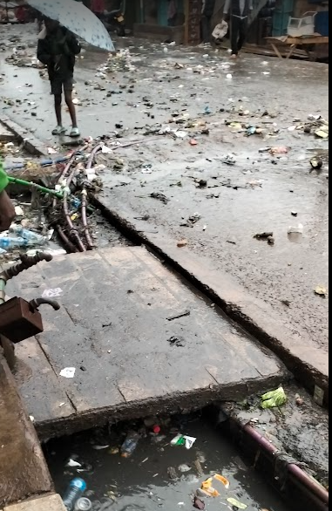
Background
Drinking contaminated water may result in waterborne infections and spread AMR
Waterborne diseases are common, accounting for 70% of epidemic-related emergencies in Kenya.
AMR deaths were 1.3M in 2019 and may be 10M in 2050.
WHO Global antibiotic resistance surveillance report 2025 indicate that 1 in 6 bacterial infection is caused by multidrug resistant pathogen especially in LMICs
AMR surveillance in Kenya neglects the environmental aspect
Informal water account for 98% of water consumed in Kibera informal settlements , however its quality is unknown

Slide 4
Objectives
Main objective
To determine the prevalence, pathotype distribution and anti microbial susceptibility profiles of E. coli isolated from informal water sources in Kibera.
Specific Objectives
To determine the prevalence of E. coli in Kibera informal settlements
To determine the antimicrobial susceptibility patterns of E. coli isolated.
To determine pathotypes of E. coli isolated in Kibera informal settlements

Slide 5
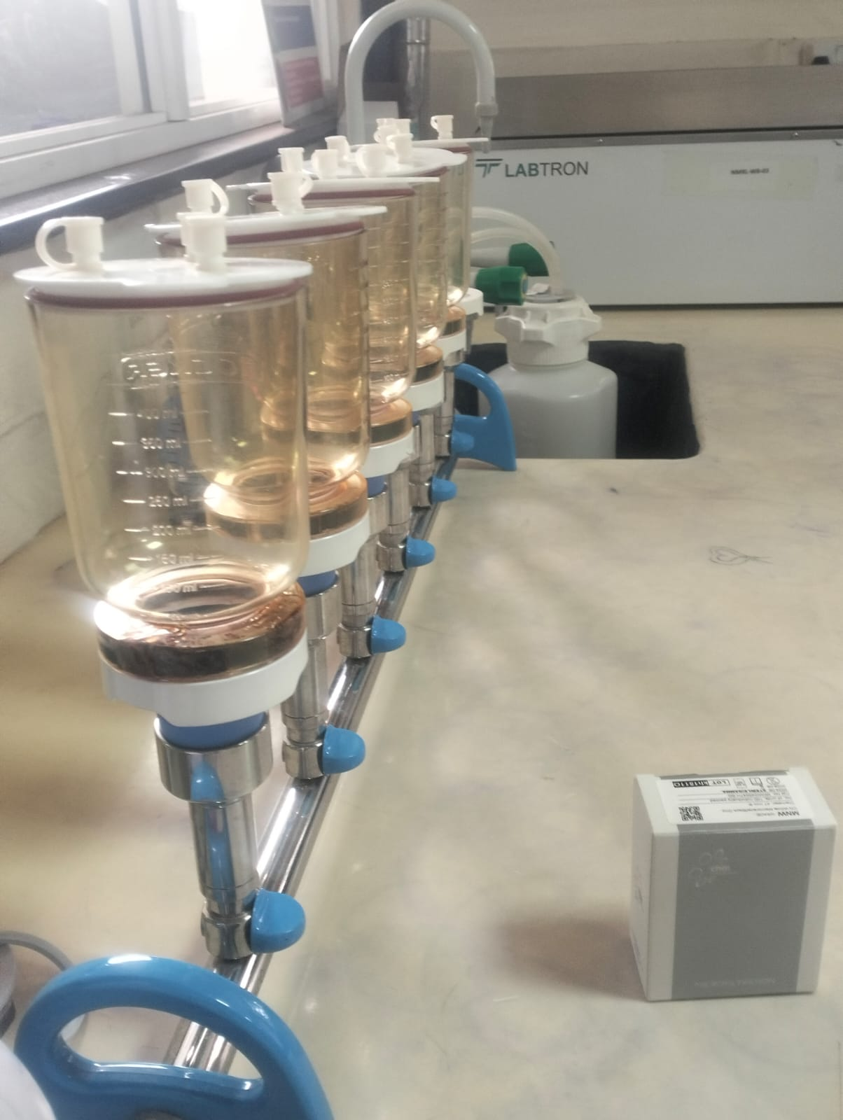
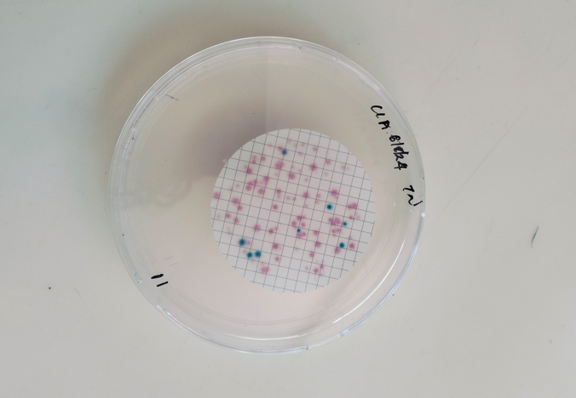
Methodology
Cross-sectional study in Kibera informal settlements
72 water were purposefully sampled in July 2024 , 6 samples per village.
E. coli enumeration: membrane filtration
Confirmation of E. coli: biochemical tests, gram stain, TSI and SIM.

Slide 6
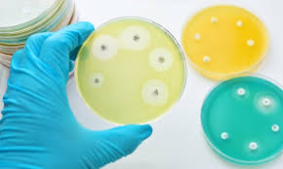
and PCR Master Mix 2 contained primers targeting,, and
Methodology
Antimicrobial Susceptibility Testing: disk Diffusion method using CLSI 2024.
Tested antibiotics:
  Ampicillin
  trimethoprim-sulfamethoxazole
  Ciprofloxacin
  Ceftazidime
  Gentamicin
  Cefuroxime
  Cefepime
  Nalidixic acid
  meropenem a
  tetracycline.

Slide 7
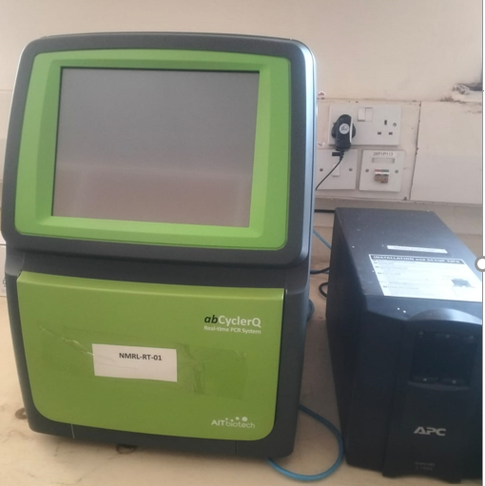
and PCR Master Mix 2 contained primers targeting,, and
Methodology
Molecular typing of E. coli:
DNA extraction by QIAamp DNA Mini kit
Real time multiplex PCR:
Data Analysis: Ms excel, WHONET (2024) and stata version 16
Target genes | Pathotype
eae (intimin) | Enteropathogenic E. coli (EPEC),
aggR (aggregative adherence regulator) | Enteroaggregative E. coli (EAEC)
stx1 and stx2 (Shiga toxins 1 and 2) | Enterohemorrhagic E. coli (EHEC)
ipaH (invasion plasmid antigen H) | Enteroinvasive E. coli (EIEC)
lt (heat-labile toxin) and st (heat-stable toxin) | Enterotoxigenic E. coli (ETEC)
daaE (Dr-binding adhesin family protein) | Diffusely Adherent E. coli (DAEC)

Slide 8
Results
Description of informal water sources in Kibera informal settlements
Sources of informal water
Pollution sources
Treatment methods used
Pollution Sources | Count of Exposed Samples | Percent of Exposed Samples
Sewage | 36 | 50.00%
Public toilet | 4 | 5.56%
Dusty rooftop | 2 | 2.78%
None | 30 | 41.67%
Figure 1
Figure 2

Slide 9
Results
Prevalence of E. coli
E. coli was detected in 21 out of 72water samples (29.2%).
E. coli concentration ranged from 0 to 87 colony‑forming units (CFU) per 100 ml.
Overall mean was 4.5 CFU/100 ml.
Both the median and the mode were 0 CFU/100 ml
Figure 3

Slide 10
Results
E. coli contamination by source, treatment and pollution source
Figure 5

Slide 11
Conclusion
Results
Antimicrobial susceptibility profile of E. coli
Most effective antibiotics were:
gentamicin (95.2% sensitivity)
meropenem (93.7% sensitivity)
ciprofloxacin (85.7% sensitivity)
Highest resistance rates were observed in:
ampicillin (90.5%)
cefuroxime (76.2%)
cotrimoxazole (57.1%)

Slide 12
Results
No. of antibiotics | Resistance pattern | Frequency | No. of isolates
1 | AMP | 3
 | CXM | 1 | 4
2 | AMP CXM | 4
 | AMP SXT | 1
 | AMP TE | 1 | 6
4 | AMP NAL CXM SXT | 1
 | AMP TE SXT CXM | 1 | 2
5 | SXT NAL CXM CHL CAZ | 1
 | AMP TE SXT CXM CAZ | 1
 | AMP SXT CXM CAZ FEP | 1 | 3
7 | AMP SXT CIP CXM CAZ C FEP | 1
 | AMP NAL SXT TE CXM CAZ FEP | 1 | 2
8 | AMP CHL NAL TE SXT CXM CAZ FEP | 1
 | AMP NAL TE SXT CXM CHL CAZ FEP | 1 | 2
10 | AMP NAL TE SXT CXM CAZ CHL FEP MEM CIP | 1 | 1
11 | AMP NAL MEM TE SXT CHL CIP CXM CAZ FEP GEN | 1 | 1
MDROs were detected in 11 out of 21 isolates (52.4%).
Key: AMP-Ampicillin, CXM-cefuroxime, SXT-Cotrimoxazole, TE-Tetracycline, NAL-Nalidixic acid, CHL-Chloramphenicol, CAZ-Ceftazidime, FEP-Cefepime, MEM-meropenem CIP-Ciprofloxacin and GEN-gentamicin.

Slide 13
Results
Policy Impact and Implications
Pathotype | Detected target gene | Total
EAEC | aggR | 5 (24%)
EIEC | IpaH | 1(5%)
EPEC | Eae | 2(10%)
ETEC | lt/st | 3(14%)
ETEC/EAEC | lt/st/aggR | 3(14%)
EPEC/ETEC/EAEC | lt/st/aggR/eae | 1(5%)
EHEC | None | 0(0%)
DAEC | None | 0(0%)
Negative | None | 6(29%)
Four pathogenic E. coli pathotypes were identified:
  EAEC was the most frequent (24%)
  ETEC (14%)
  EPEC (10%)
  EIEC (5%)
  mixed types (19%)
Six samples were negative.

Slide 14
Conclusion
Policy Impact and Implications
Informal water sources in Kibera informal settlements were contaminated with E. coli at 29.2%.
Contamination was associated with acquisition of water through illegal means, inadequate treatment and pollution exposure as seen in other slums in Kenya
High resistance to ampicillin (90.5%) and cefuroxime (76.2%), the emergence of carbapenem-resistant strains coupled with multidrug resistance organisms (52.4%) reflects the AMR patterns observed in Kenya and East African
Molecular characterization found EAEC to be the most frequently detected (24%), followed by ETEC(14%), EPEC (10%), EIEC(5%) and mixed combinations(19%). This reflected the complexity of waterborne E. coli transmission
Informal water sources in Kibera harbor a substantial burden of multidrug-resistant and pathogenic E. coli, posing a significant public health risk,

Slide 15
Policy Impact and Implications
Strengthen water infrastructure to reduce reliance on unsafe sources (boreholes, water trucks, rainwater).
Implement regular water quality monitoring and improve sanitation to prevent fecal contamination.
Promote household-level water safety through boiling, chlorination, filtration, and solar disinfection with user training.
Enhance community engagement and health education via local leaders and health workers.
Enforce antimicrobial stewardship — regulate antibiotic use, drug sales, and expand AMR surveillance under a One Health approach.
Integrate research findings into urban planning and public health policy.
Support continued research on waterborne pathogens and E. coli resistance mechanisms

Slide 16






Thank you!
Scan to visit our website
#KeHSCon2026
@NPHIKenya
www.nphi.go.ke

